Slide 1
Social App Ver 1.0
Team Member(s): Shamsed Mahmud
Sirisha Singaraju Product Owner(s):Rick Little Mohsen Taheri Course Instructor: Masoud Sadjadi
Final Presentation
Fall 2016
School of Computing and Information Sciences Florida International University
Notes:
7 seconds.
Greet your audience, thank them for attending your presentation, introduce yourself, introduce your project, introduce your team members, and quickly indicate what each of you did in a high-level manner, and put more emphasis on your part/contribution.

Slide 2
Problem Description
E-SToPP organization had a static website
Add functionality to make it dynamic
Create a Mobile Application

Slide 3
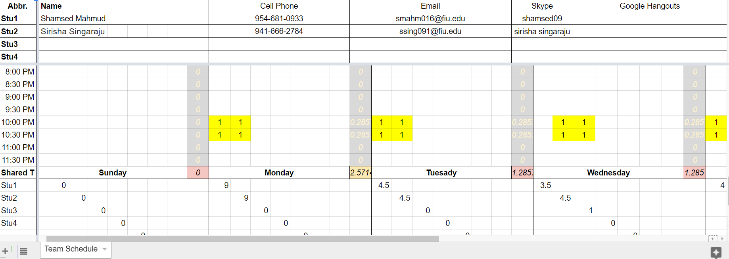
Project management

Slide 4
User Stories-1
1. User Story-89: Application Launch
2. User Story-120: Testing Home and Blog feature of Android Application
3. User Story-121: Testing Calender and Contact feature of Android Application
4. User Story-122: Deployment of App in the Google Play
5.User Story-123: Performance Enhancement and Progress Bar
Notes:
5 seconds.
List the user stories that you worked on them.(put in order of importance). Stay focused on the parts that you have been working.

Slide 5
User Stories-2
6. User Story-125: Adding E-mail and Message to Web and mobile Application
7. User Story-126: Add Get-In-Touch form to Web and mobile Application
8. User Story-127-128: Convert PPLM form to dynamic web and Mobile Application
9. User Story-130 and 132: Convert Transformative Education Center and Transformative Praxis Center form into dynamic web application and Mobile Application

Slide 6
User Stories-3
10.User Story-129 and 131: Convert Transformative Research Form and Add banner to e-stop website.
11.User Story 133: Add search Option to e-stop website and Mobile Application
12. User story 134: Add Instagram to e-stop website and Mobile application

Slide 7
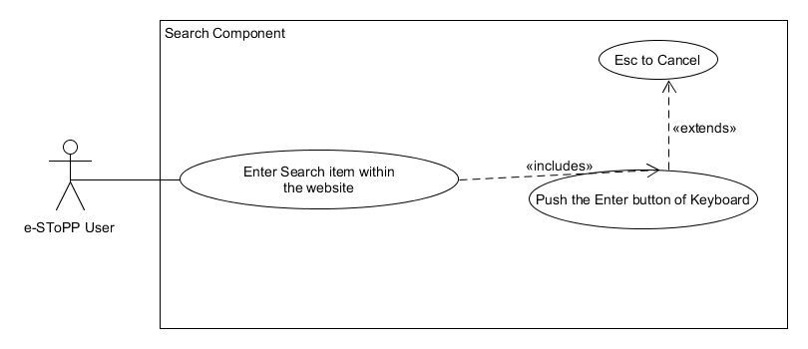
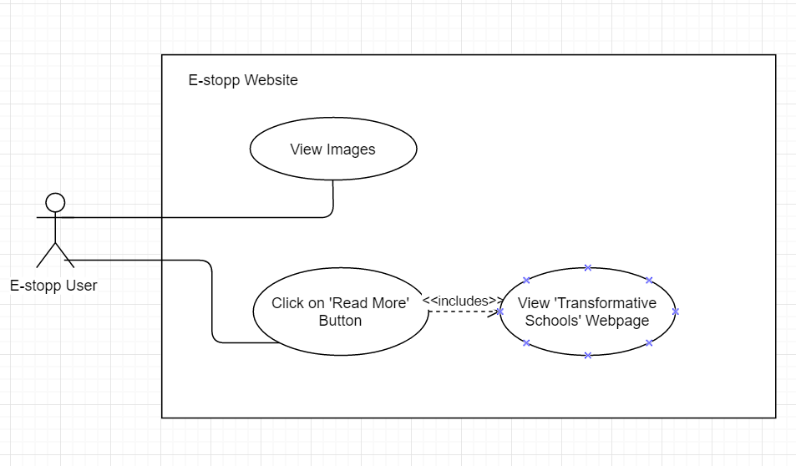
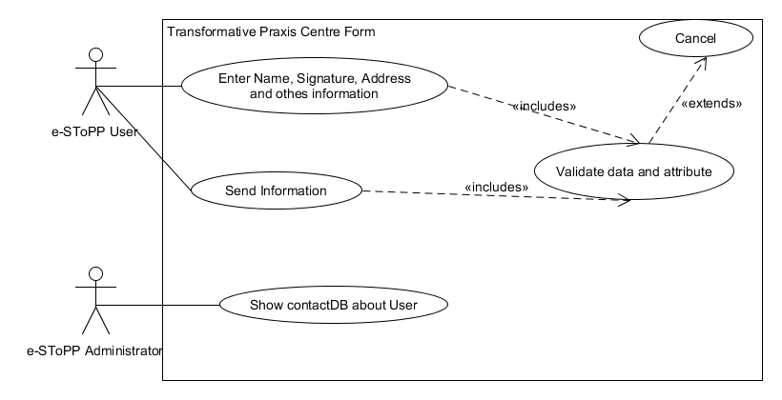
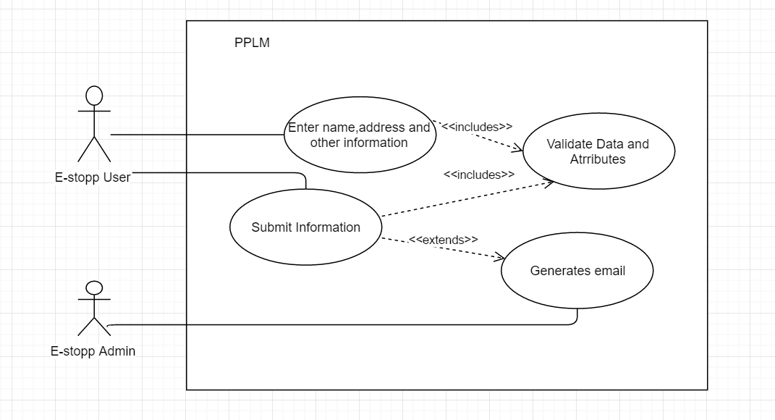
Requirements: Use Cases-1
Notes:
5 seconds
Show the Use Case Diagram for the whole project. Highlight your use cases.

Slide 8
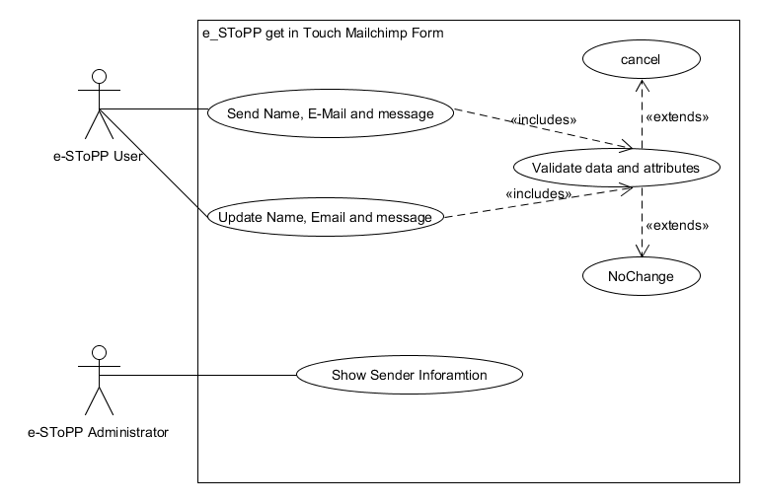
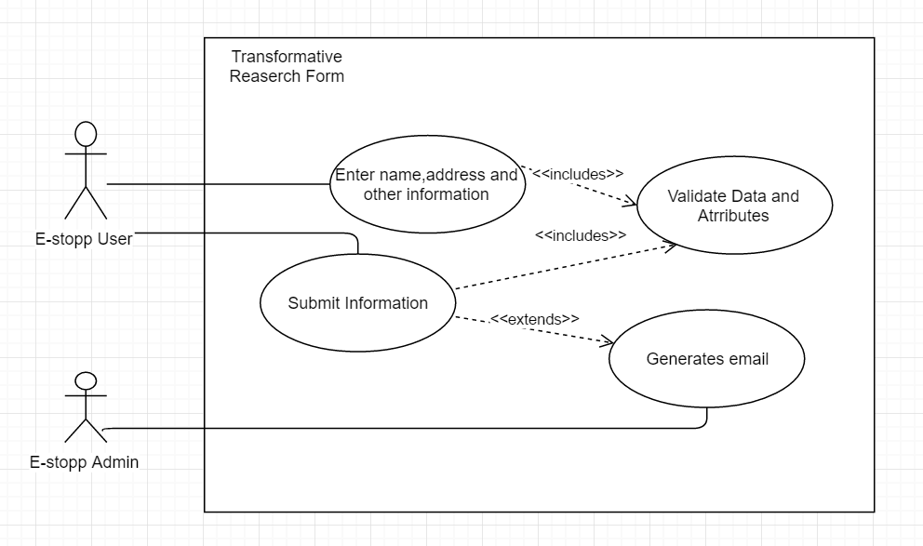
Requirements: Use Cases-2

Slide 9
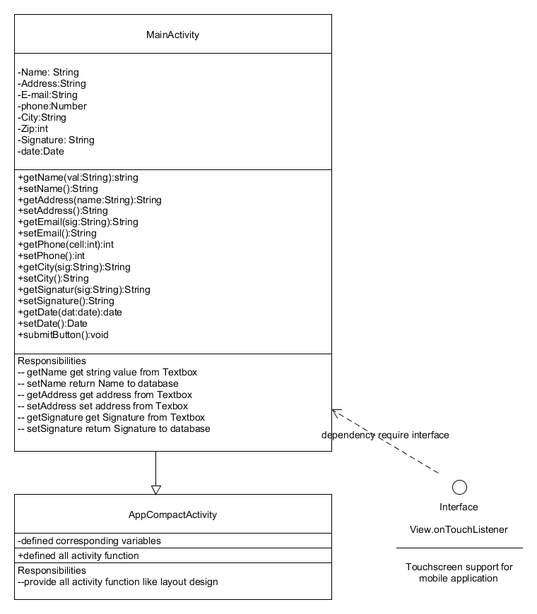
Class Diagrams-1
Notes:
10 seconds.Minimal class diagram. Highlight the classes that you created/modified
Identify the design patterns used (one or more slides).

Slide 10
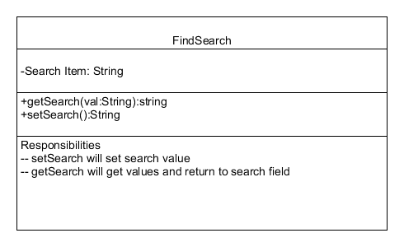
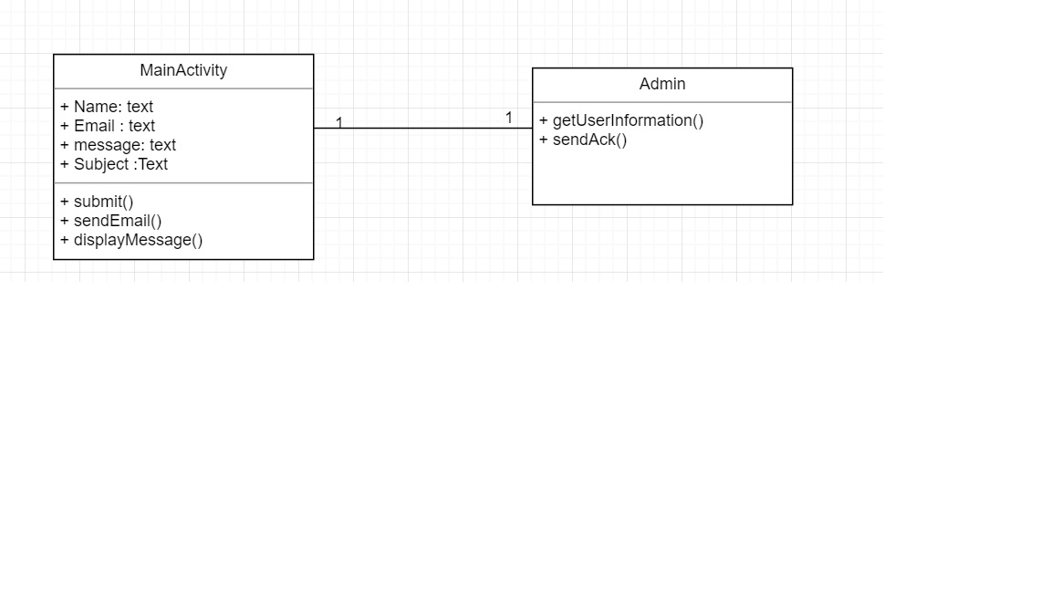
Class Diagrams-2

Slide 11
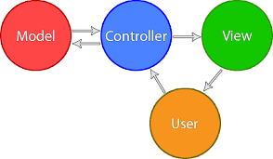
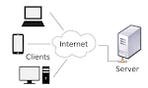
System Design: Architecture (MVC and Client Server Architecture)
Notes:
20 seconds
System design: Highlight the parts that you contributed to them.
1. System decomposition; identify the architecture patterns used
2. System deployment – h/w and s/w requirements

Slide 12
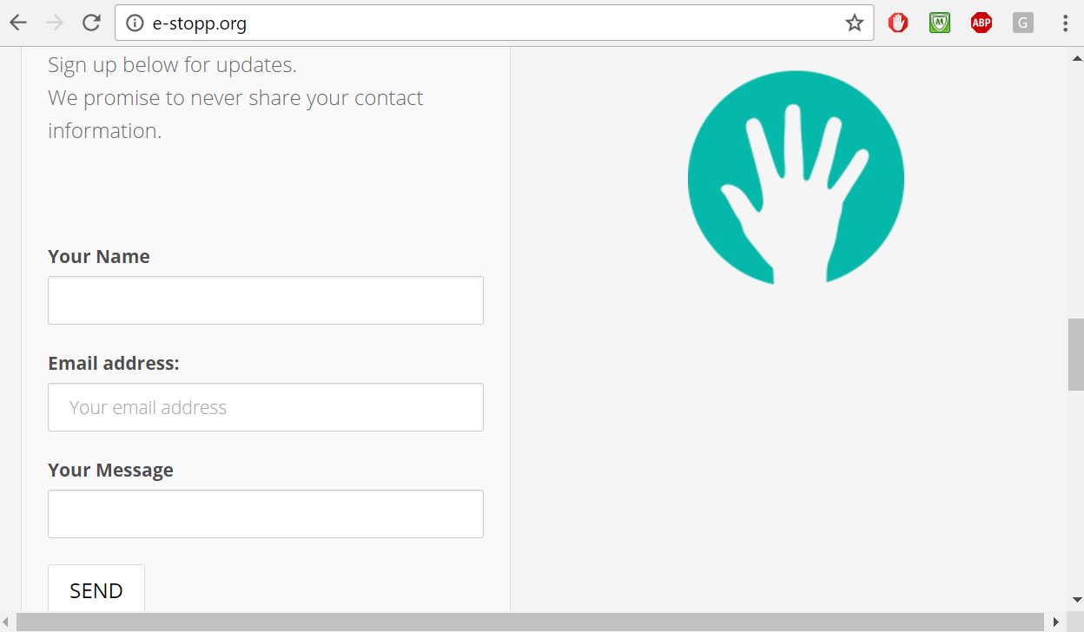
Add functionalities and Create the Mobile Application version 1.0 of Social App Ver 1.0 Project

Slide 13

Add functionalities and Create the Mobile Application version 1.0 of Social App Ver 1.0 Project

Slide 14
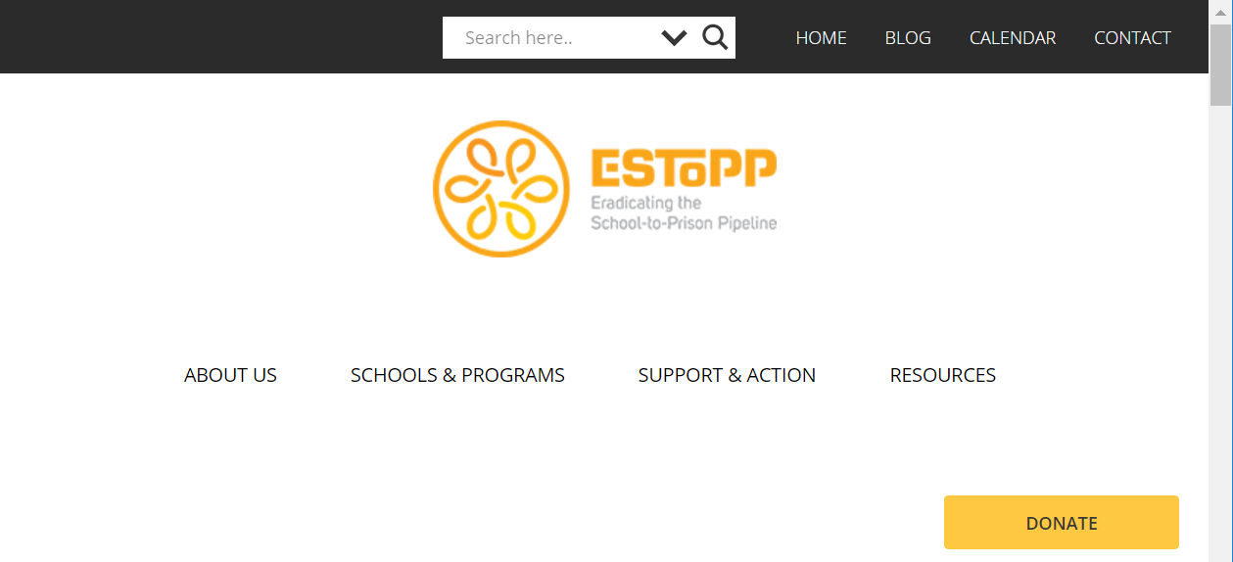
Add functionalities and Create the Mobile Application version 1.0 of Social App Ver 1.0 Project
Notes:
10 seconds.
Introduce the problem that the whole project (in all versions) tackles with GIF or screenshot.

Slide 15
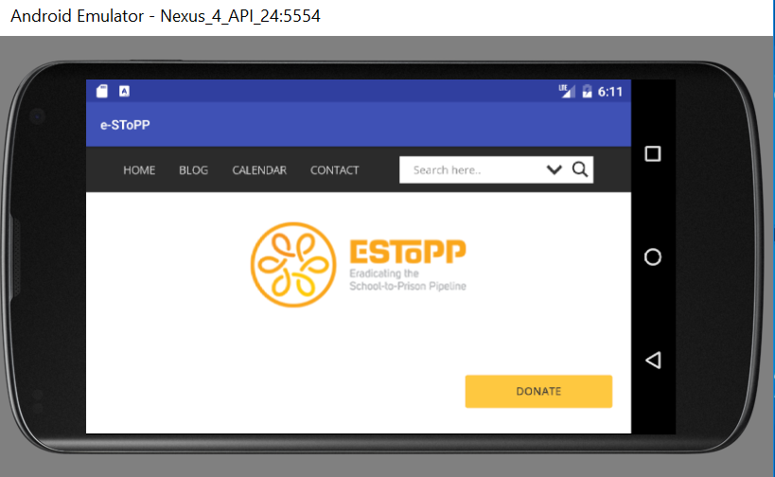
Add functionalities and Create the Mobile Application version 1.0 of Social App Ver 1.0 Project
Notes:
20 seconds.
Introduce the problem that the your project (in new version) tackles with GIF or screenshot.

Slide 16
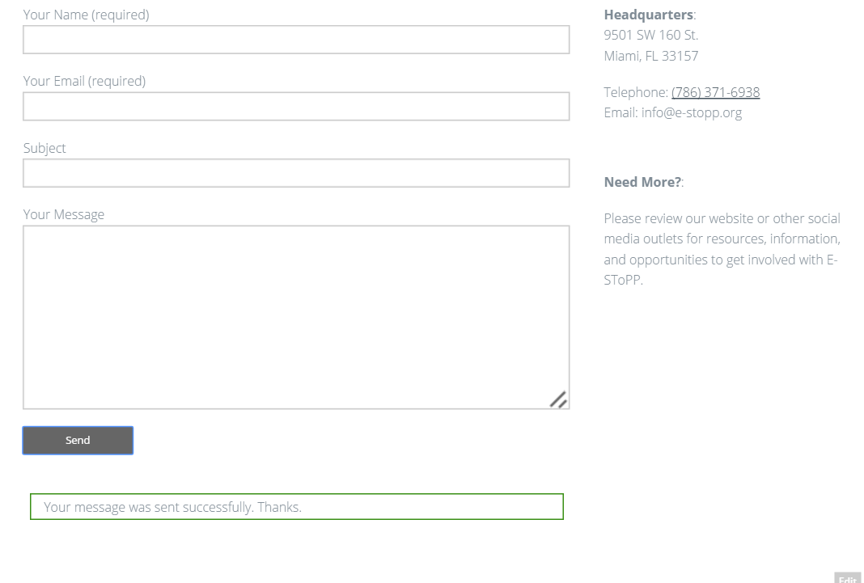
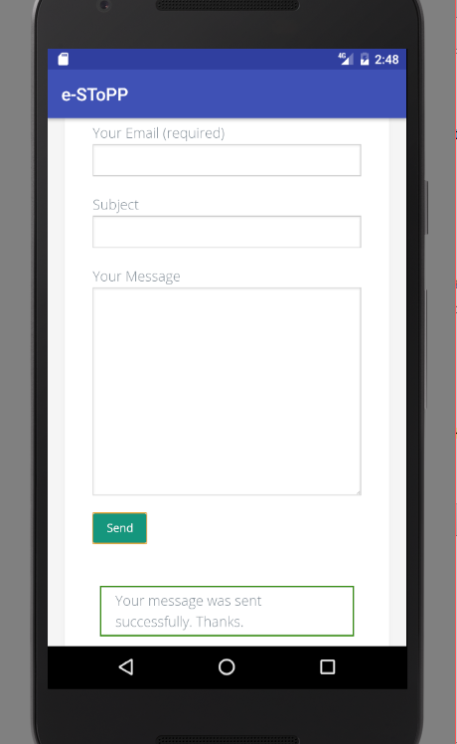
User Story-125: Adding E-mail and Message to Web and mobile Application
Notes:
60 seconds
The tile of user story
The most important user story you worked on it. You have to describe this one very well and be proud of that.
Please present and show the complexity of your work, code, algorithms, and technical challenges and technologies you have used. (you could use screenshot if you want. Visual presentations are better than text presentation)
Go into the details of the most important/significant tasks using bullet lists or visual graphs or state chart diagram
Sequence Diagram for this user story is mandatory (in another separate page if required)
Demo using screenshots or GIF (in another separate page if required)

Slide 17
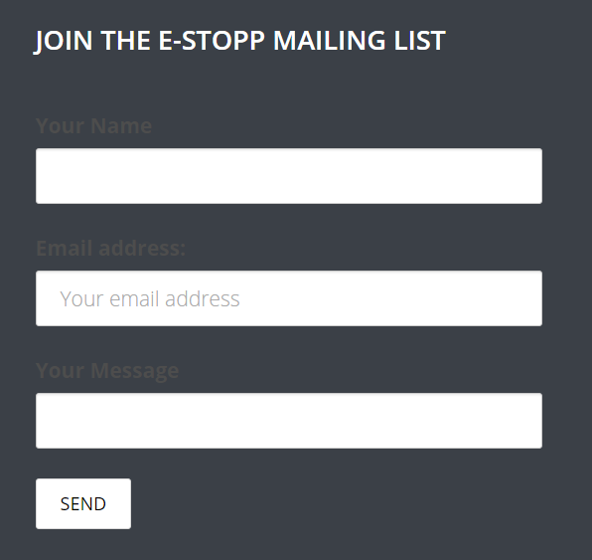
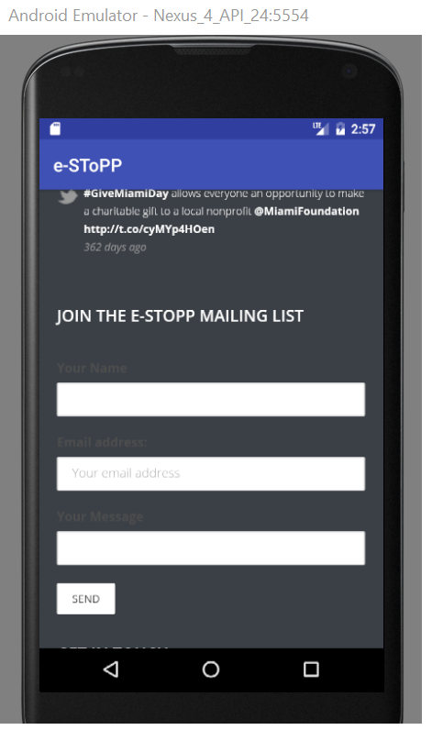
User Story-126: Add Get-In-Touch form to Web and mobile Application
Notes:
20 seconds
The tile of user story
Please present and show the complexity of your work, code, algorithms, and technical challenges and technologies you have used. (you could use screenshot if you want. Visual presentations are better than text presentation) - Go into the details of the most important/significant tasks using bullet lists or visual graphs or state chart diagram - Demo using screenshots or GIF (in another separate page if required)
Sequence Diagram for this user story is optional

Slide 18

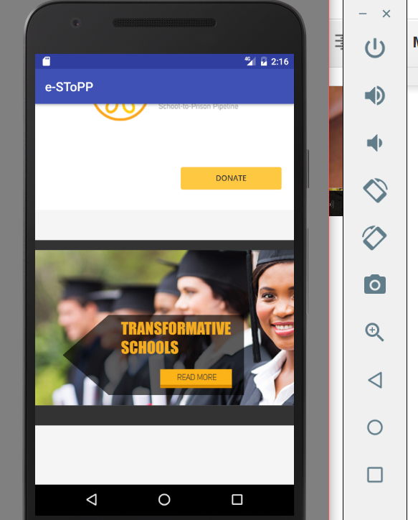
User Story-131: Add banner to e-stop website
Notes:
20 seconds
The tile of user story
Please present and show the complexity of your work, code, algorithms, and technical challenges and technologies you have used. (you could use screenshot if you want. Visual presentations are better than text presentation) - Go into the details of the most important/significant tasks using bullet lists or visual graphs or state chart diagram - Demo using screenshots or GIF (in another separate page if required)
Sequence Diagram for this user story is optional

Slide 19
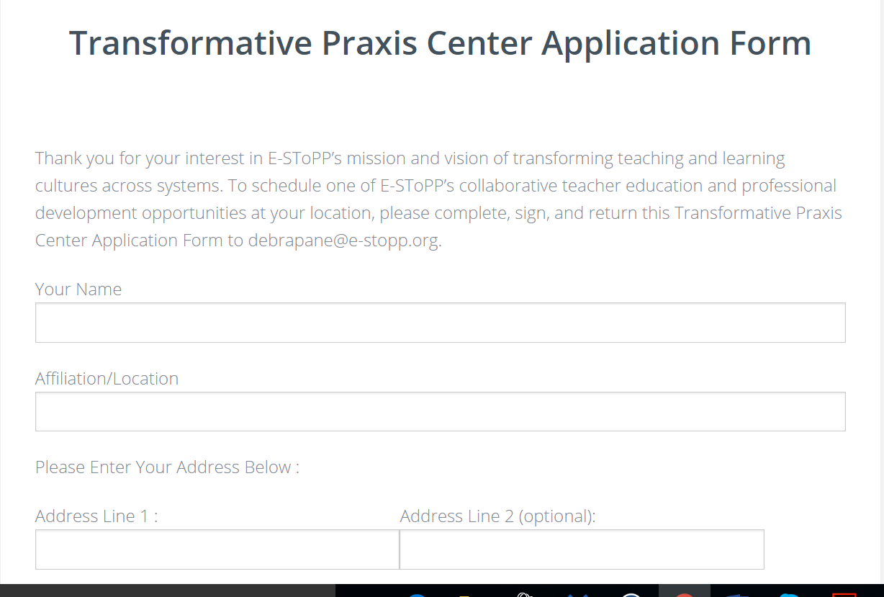
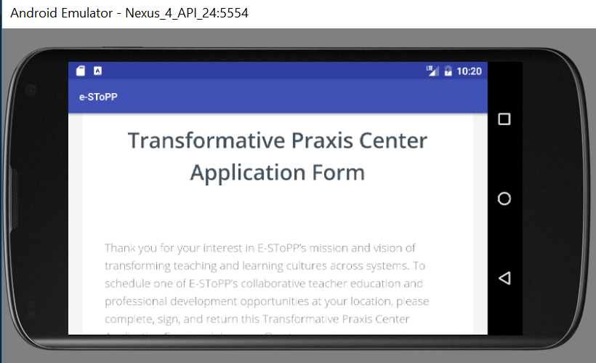
User Story-132: Convert Transformative Praxis Center form into dynamic web application and Mobile Application
Notes:
20 seconds
The tile of user story
Please present and show the complexity of your work, code, algorithms, and technical challenges and technologies you have used. (you could use screenshot if you want. Visual presentations are better than text presentation) - Go into the details of the most important/significant tasks using bullet lists or visual graphs or state chart diagram - Demo using screenshots or GIF (in another separate page if required)
Sequence Diagram for this user story is optional

Slide 20
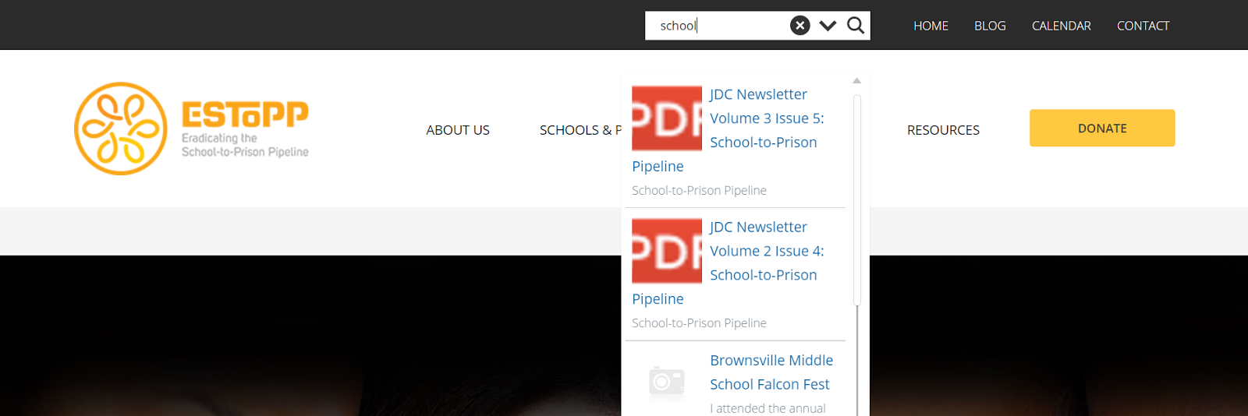
User Story 133: Add search Option to e-stop website and Mobile Application
Notes:
20 seconds
The tile of user story
Please present and show the complexity of your work, code, algorithms, and technical challenges and technologies you have used. (you could use screenshot if you want. Visual presentations are better than text presentation) - Go into the details of the most important/significant tasks using bullet lists or visual graphs or state chart diagram - Demo using screenshots or GIF (in another separate page if required)
Sequence Diagram for this user story is optional

Slide 21
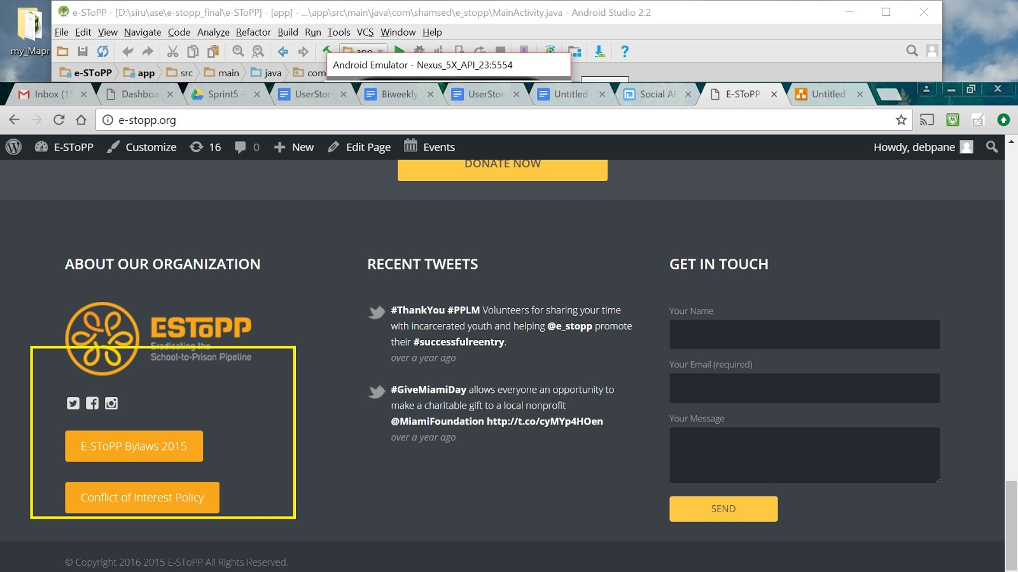
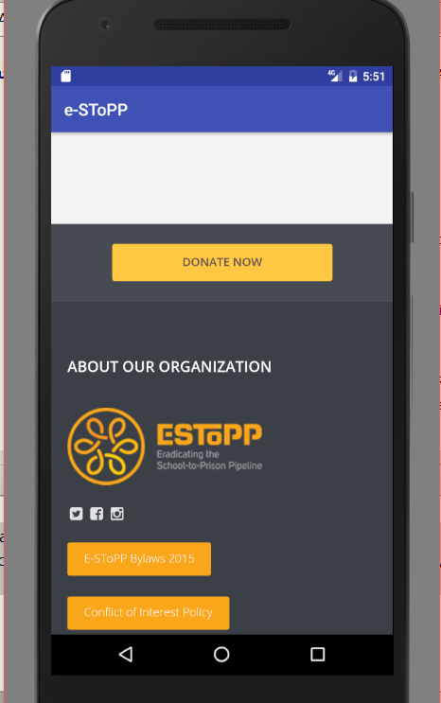
User story 134: Add Instagram to e-stop website and Mobile application

Slide 22
Sunny Test Case
Test Id: Testing#133-TC001
Purpose: When I enter into the website and click on search component and write any search item it will show us all related topics within the website.
Precondition: The user should be in the e-SToPP.org website The website or Mobile app should be in the running state
Input: The user should input the search topic
Expected Result All search result will be available here. Then if he/she select any item and press the enter button then it will show the corresponding document , Thanks- Working OK
Notes:
10 seconds
A description of verification process and Test Suites and Test Cases for one of the use cases.
1 One sunny day and one rainy day for the implemented use cases (one or more slides).
2 Automated test scripts for the implemented use cases (if any) (one or more slides).

Slide 23
Rainy Test Case
Test Id: Testing#133-TC003
Purpose: If the user input such data that is not available in the website. It will say “No result”. Did you mean something related to it.
Precondition: The user should be in the Mobile App or in the home page of Website The App or website should be in the running state
Input: The user should input data that is not available in the website.
Expected Result We get:” No Result. Do you mean something close to it”.-working ok

Slide 24








Summary
E-SToPP website has been modified
and it’s Mobile Application works
fine.
contact information
smahm016@fiu.edu
ssing091@fiu.edu
Questions?
Thank You!
Notes:
10 seconds
Summarize your contribution, mention your effort for Scrum, Mingle, Github, Google Drive Documentation and minutes
Include your contact information
Ask if anyone has any questions for you.
Thank your audience

